Slide 1
Erosion Processes and Prediction in NW U.S Forests
ES 407 Senior Seminar, Dr. Taylor
Presented by: Timothy Hagen

Slide 2
Overview

Slide 3
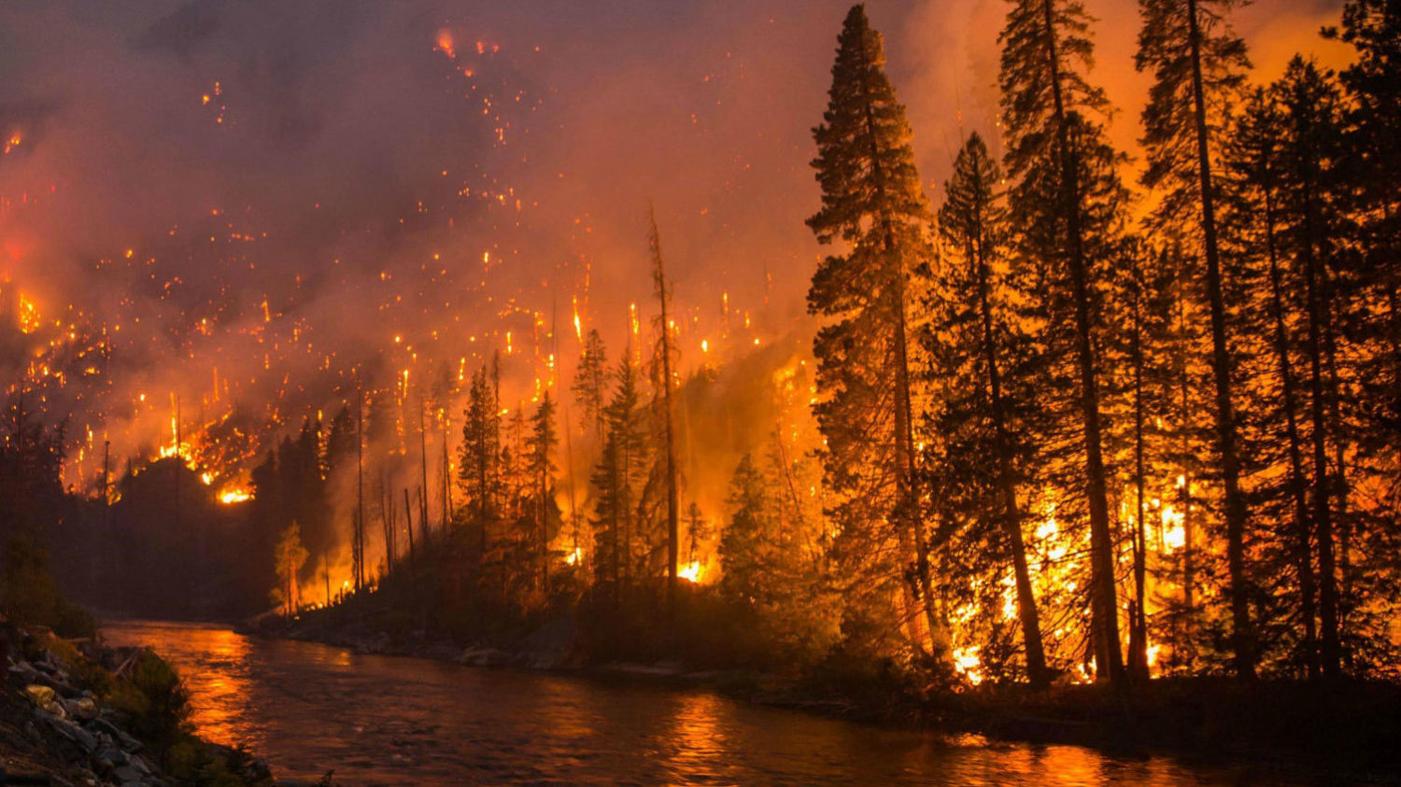
Overview
Introduction
Erosion on the surface:
Wildfire
Forest management
Roads
Logging
Predictive tools
Conclusion and summary

Slide 4
Introduction

Slide 5
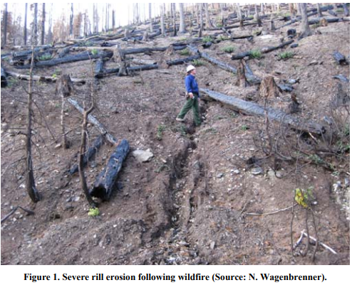
Introduction
Sediment generated by:
Surface erosion
Mass wasting
Stream channel erosion
Main disturbances
Wildfire
Roads
Rates very in studies

Slide 6
Erosion on the Surface

Slide 7
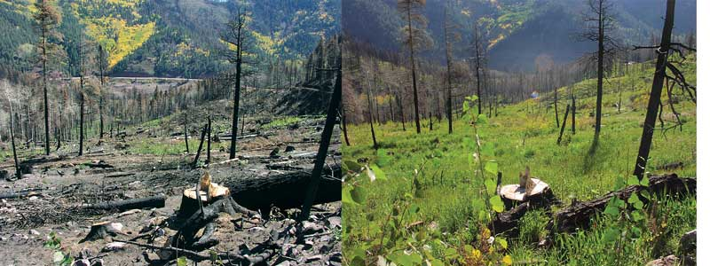
Erosion on the Surface: Wildfire
Wild fire takes away structure
NW forests are fire adapted
Weather dependent

Slide 8
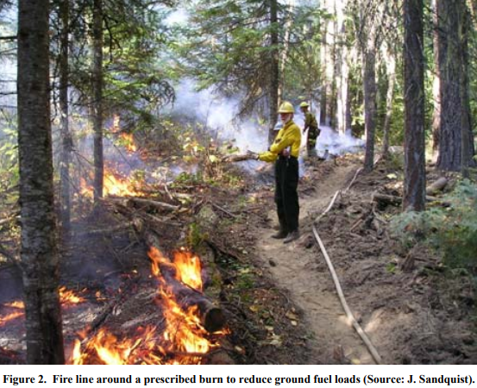
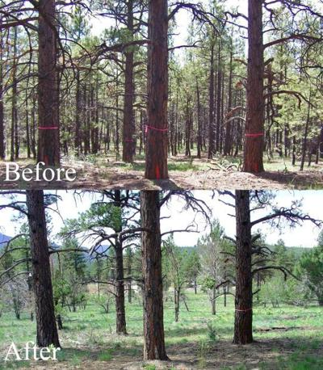
Erosion on the surface: Management
Fuel management: controlled burning, thinning
Erosion rates of management minimal compared to wildfire

Slide 9
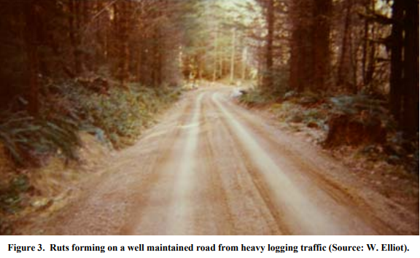
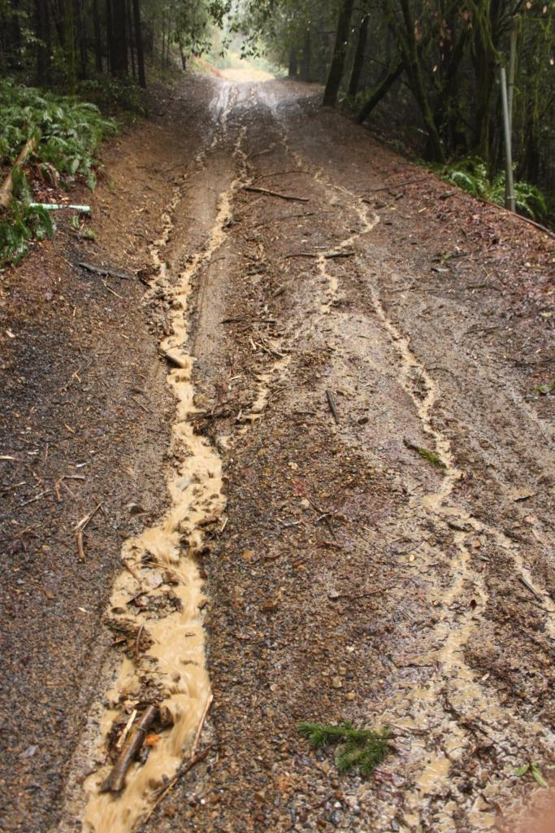
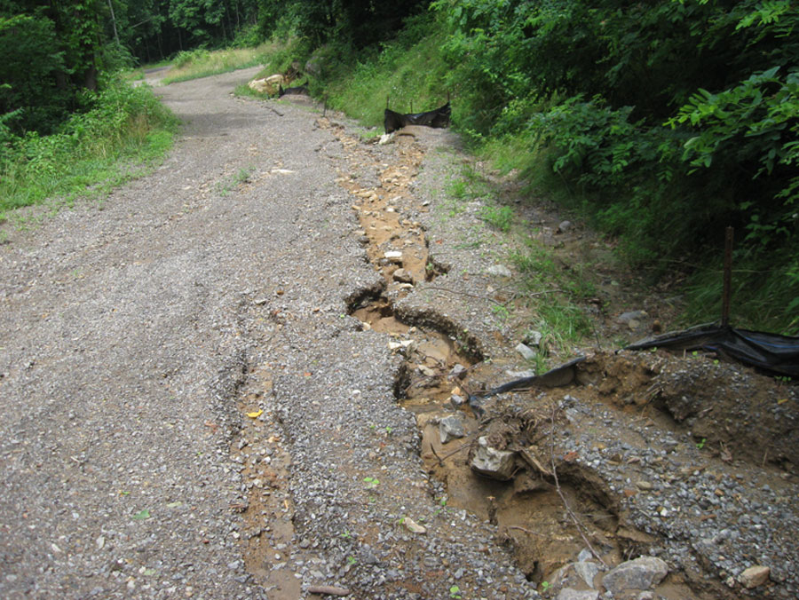
Erosion on the surface: Roads
Roads are the second major source of sediment
Rates very on type and use
Newer roads produce the most

Slide 10
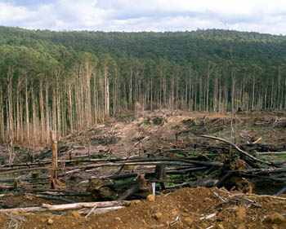
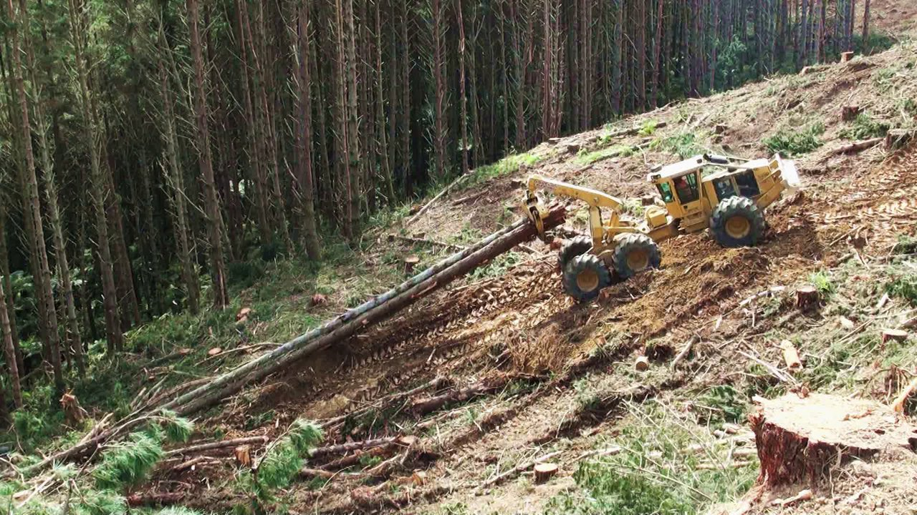
Erosion on the surface: Logging
Our methods of logging also impact sediment erosion
Skid logging depends on location
Other logging operations can produce just as much sediment

Slide 11
Predictive Tools

Slide 12
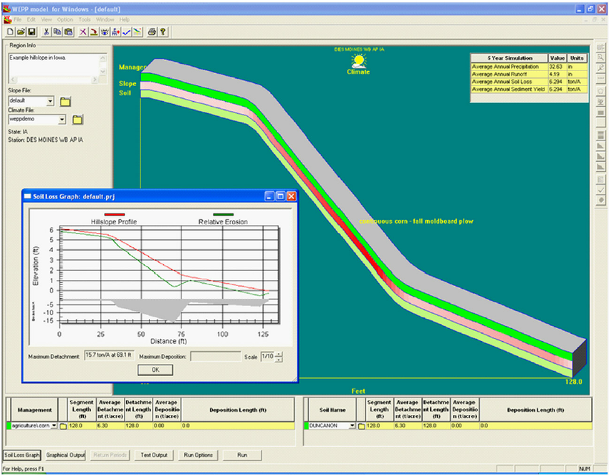
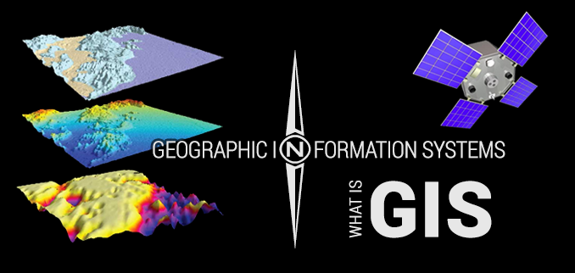
Predictive tools
GIS
WEPP
FSWEPP

Slide 13
Conclusion

Slide 14
Summary and Conclusion
Greatest amount of sediment are from:
Wildfires
Roads
The different ways we manage things can lead to higher or lower rates of sediment
Predictive models are used to look at rates in different ways

Slide 15
Clear cut logging and sediment production in the Oregon Coast Range

Slide 16
Overview

Slide 17
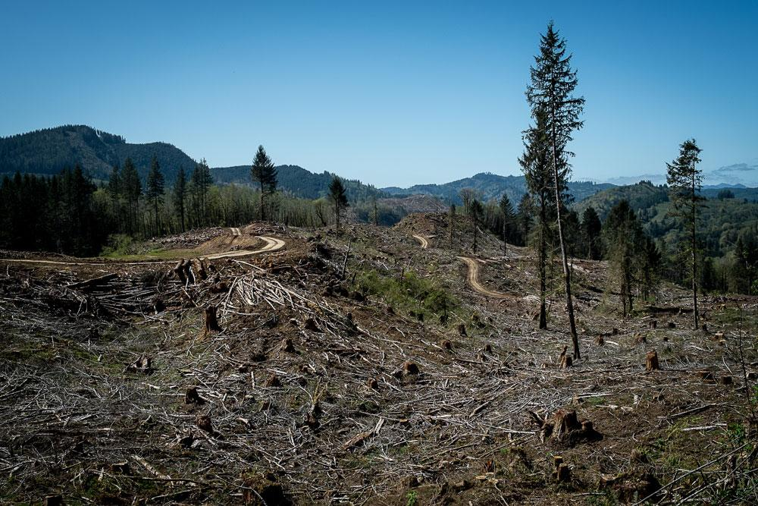
Overview
Introduction
Location
The study/Goals
Results
Conclusion and summary

Slide 18
Introduction

Slide 19
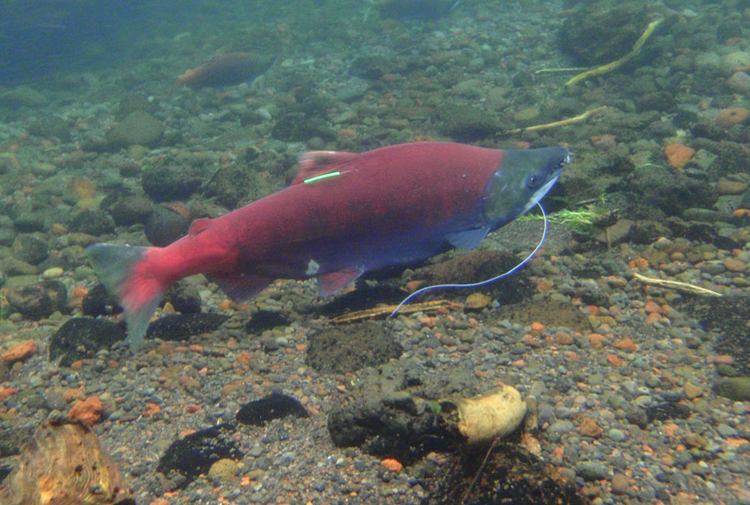
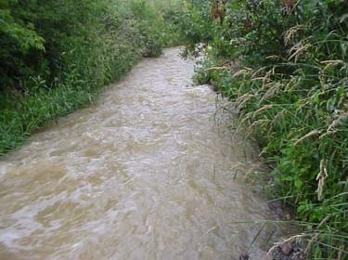
Introduction
Road cutting, clear cutting and slash burning
Effects on fish:
gill injury
Spawning grounds
Rates after logging operations

Slide 20
location

Slide 21
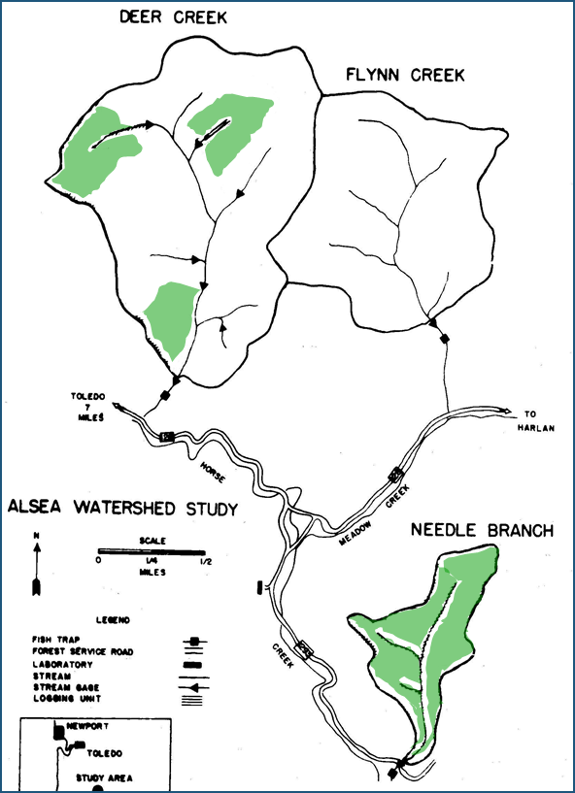
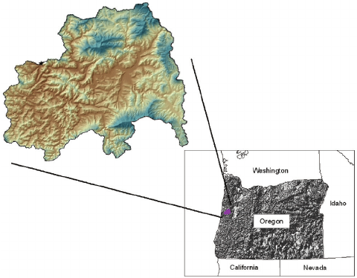
Location of Study
Alsea Watershed, Alsea Oregon
Three small watersheds within

Slide 22
Goals

Slide 23
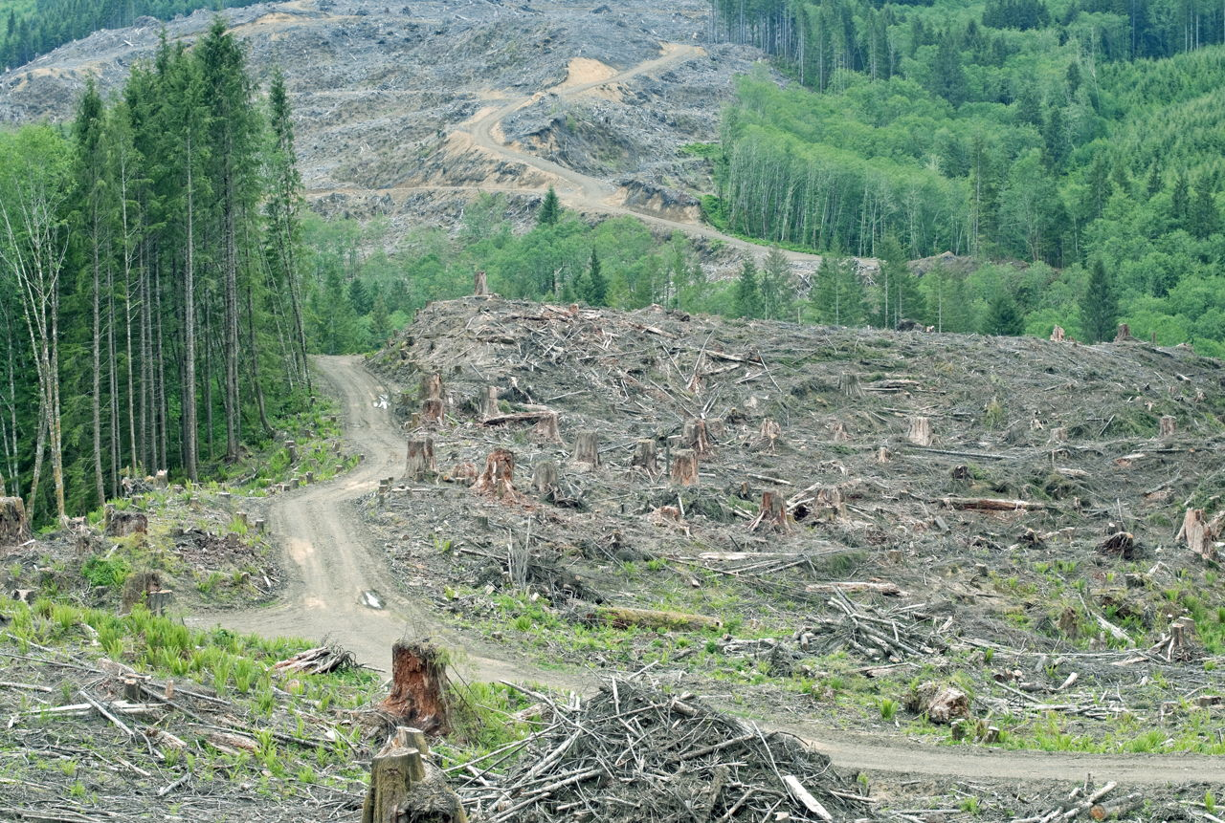
Goals of the Study
Study effects of logging on:
Water quality
Fishery recourses
Sediment erosion
Began 1958
30%, 60%, and 90% clear-cuts
Measured before and after.

Slide 24
Results

Slide 25
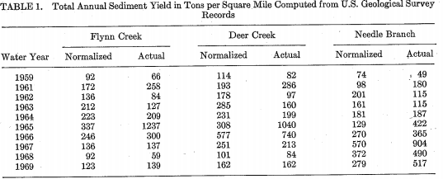
Results of the study
Increases can be seen after experiments were completed
Also notice the normalization in following years

Slide 26
Conclusion

Slide 27
Conclusion and summary
Study should major effects of sediment yield following logging, road building, and burning
Rates normalized within a few years
Water quality was effected closer to source and added more sediment to the water.
Standards don’t regulate this
Further study is required

